Slide 1
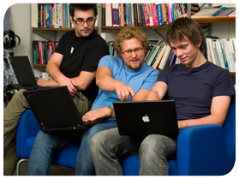
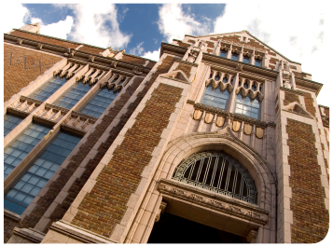


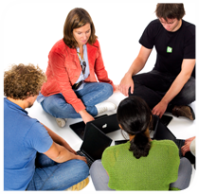

.
Qt in Education
Qt Quick
Notes:
This lecture introduces Qt Quick.
It discusses QML, basic elements, states, transitions, how to build components and very basic C++ to QML integration.
Recommended reading:
http://doc.qt.nokia.com/4.7/qtquick.html
http://doc.qt.nokia.com/4.7/qdeclarativeintroduction.html
http://doc.qt.nokia.com/4.7/qdeclarativestates.html
http://doc.qt.nokia.com/4.7/qmlruntime.html
http://doc.qt.nokia.com/4.7/qtbinding.html

Slide 2


© 2011 Nokia Corporation and its Subsidiary(-ies).
The enclosed Qt Materials are provided under the Creative Commons
Attribution-Share Alike 2.5 License Agreement.
The full license text is available here:
http://creativecommons.org/licenses/by-sa/2.5/legalcode.
Nokia, Qt and the Nokia and Qt logos are the registered trademarks
of Nokia Corporation in Finland and other countries worldwide.

Slide 3
Introducing Qt Quick
C++ is great for developing applications
  Data structures
  Algorithms
  Business logic
  Structured user interfaces
C++ is not so great for modern device user interfaces
  Many objects active in parallel
  Many, potentially overlapping states
  Timer-driven, fluid changes
Notes:
C++ is a great language for developing code for data structured, algorithms, business logic and widget-based, structured, user interfaces
C++ starts to feel uncomfortable when implementing modern device user interfaces. These typically consists of many objects active at once, many (overlapping) states and timer driven transitions.
The code easily gets overwhelming just by the sheer number of objects and actions that needs to be kept in sync.
Qt Quick bridges these difficulties, while maintaining the power of C++
Continues

Slide 4
Introducing Qt Quick
Using Qt Quick, the business logic and performance critical operations can be implemented in C++
The user interface can be written using QML
  Qt Meta-object Language
  Declarative
  Based on JavaScript
Notes:
Using Qt Quick, the business logic and everything critical to performance can be implemented using C++.
The user interface, however, is implemented using QML – the Qt Meta-object Language
QML is a declarative language based on JavaScript
It is target towards the areas where C++ is not so convenient
The idea is for QML to be a language that is designed for handling many objects in a setting where many states and transitions between states need to be handled.
Qt Quick as a full product will be released beginning of 2011 with the tooling support in Qt Creator, but QML and Qt Declarative were released as part of Qt 4.7.0
Continues

Slide 5
Introducing Qt Quick
Qt Quick consists of
  QML – the language
    Designed for building device user interfaces
    Can be used in other application too
  Qt Declarative – the Qt module
    Contains the QML engine, context and view
    Qt bindings for QML
    Mechanisms for integrating C++ and QML
  Tooling support in Qt Creator (coming)
Notes:
Qt Quick consists of three parts:
1. QML, the language for building Qt Quick-based user interfaces
It is possible to use QML for other purposes too, but the initial goal is user interfaces
2. QtDeclarative Qt module. It contains classes for executing QML (an engine, a context and a view)
It also contains bindings for QML and mechanisms for integrating C++ and QML
3. Graphical WYSIWYG tooling support in Qt Creator (coming)

Slide 6
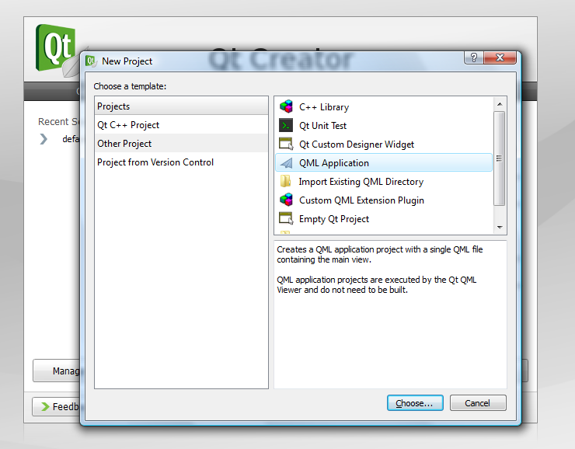
Working with QML
Qt Creator 2.0 supports QML
  Can create QML projects
  Can run and debug QML
Notes:
When working with QML, it is important to ensure that you are using Qt Creator 2.0 or later.
Qt Creator 2.0 contains support for QML. It can create QML projects and it can be used to run and debug QML applications.
WYSIWYG-editor will be released with Qt Creator 2.1 as part of the Nokia Qt SDK. There you will be able to work with Qt Quick user interfaces just as easily as you can drag and drop and configure widgets in Qt Designer.

Slide 7
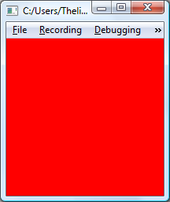
Introducing QML
QML is a declarative language based on JavaScript
Import QtQuick
components
Declare a Rectangle
element – i.e. create an
object instance
import QtQuick 1.0
Rectangle {
width: 200
height: 200
color: "red"
}
Bind properties
to values
Component names always start
with capital letters
Notes:
QML is a declarative language based on JavaScript – but what does that mean?
In the example, you can see how we first import the QML bindings of Qt, specifically for version 4.7. This is just so that we can get access to the Qt classes.
We then declare a Rectangle. This actually instantiates a rectangle object. In C++, this would have corresponded to a call to new Rectangle().
Inside the rectangle declaration, we bind a set of properties to values and that is it. We have a rectangle with dimensions and a color.
Running this example simply shows a red window. If resized, the base component, i.e. the rectangle, is stretched, and the window will always be red.
In the code, notice how component names, such as Rectangle, start with capital letters. This indicates to QML that it needs to instantiate an object.
Continues

Slide 8
Importing Resources
Importing component definitions
The import directive imports:
  Component classes from C++ modules
  Other QML modules
  JavaScript files
When importing C++ modules, the version must always be specified
import Qt 4.7
import MyCppClasses 1.2
import "from-qml"
import "scripts.js"
Notes:
The first line of our example imported the QML bindings of Qt. You can import any set of C++ classes into QML using the import directive.
You can also import modules written in QML, and modules with JavaScript code, so it is easy to write modular, well structured, applications using QML.
Notice that when importing C++ classes, the interface is bound to a specific version. This allows you to provide multiple versions of the same interface and unties the QML code for your C++ code. For instance, you can provide both the latest APIs and legacy APIs without risking name clashes and problems with altered behavior.
Continues

Slide 9
Creating Object Hierarchies
When declaring elements inside other element declarations, you create object hierarchies
Text
Rectangle {
Rectangle {
Text {
}
}
Text {
}
}
Text
Notes:
When declaring elements, thus creating object instances, you can create hierarchies. You do this by nesting the declarations of the elements.
This would correspond to calling setParent for the inner items to create a ownership hierarchy in C++. You can compare this to the object hierarchies of QWidgets used to build classic desktop dialogs.
Continues

Slide 10
Navigating the Objects Tree
It is possible to refer to the parent object using the parent name
Rectangle {
Rectangle {
width: parent.width
Text {
color: parent.color
}
}
Text {
}
}
Notes:
In a tree of elements, parent refers to the next level up in the hierarchy, in much the same way that all QObjects have a parent() method returning a pointer to the parent of that object.
Through the parent reference, you can access the parent item's properties. This means that you can relate to the properties of the parent when populating it. This way, it is easy to create user interfaces that can be dynamically resized or colored or altered in general.
Continues

Slide 11
Naming Elements
Using the id property, you can name elements
You can then refer to them by name
Rectangle {
id: outerRectangle
...
{
height: outerRectangle.height
...
Notes:
The id property is used to name elements. Again, referring back to C++, this would correspond to setting the object name property of a QObject.
That way, you can name items and then refer to them from other elements. There are scoping rules for this, so you cannot expect to be able to access all objects from anywhere. Much as you are recommended to stay away from global variables in C++.

Slide 12
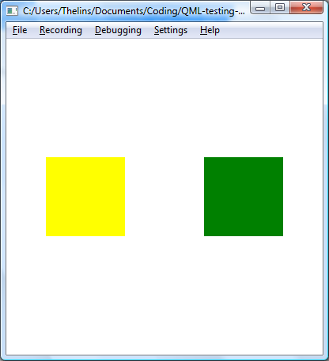
Binding Values
In QML, values are bound, not assigned
  Changing input on the right side of the “:” operator updates the left side
Rectangle {
id: firstRect
x: 10
...
}
Rectangle {
x: 400 - firstRect.x
...
}
Notes:
In QML, values are bound, not assigned. This means that if the right hand side of the colon operator changes, the property to the left will be updated automatically
This does not mean much in the static case, i.e. x: 10.
For instance, in the example here, the two rectangles are placed at different x-positions, where the second rectangles x-position is based on the position of the first. The second rectangle is the interesting part as its x-position relates to the x-position of the first rectangle.
(firstRect is yellow, the second is green in the illustration)
Continues

Slide 13
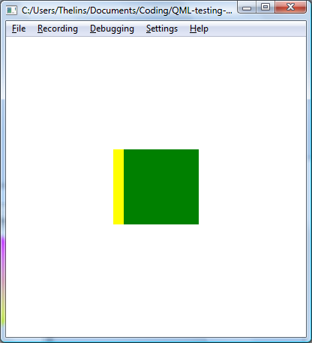
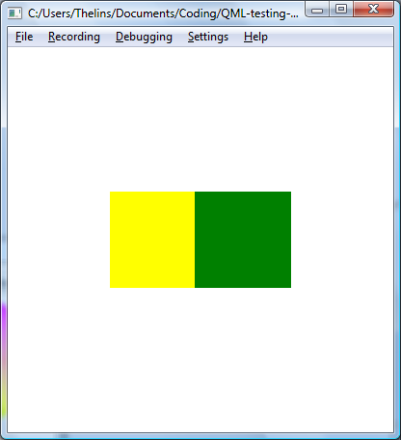
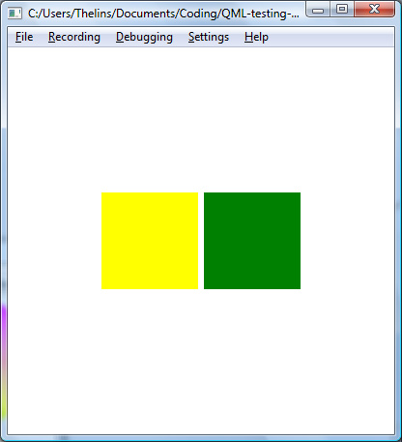
Animating Values
Property values can be animated
Rectangle {
id: firstRect
}
Rectangle {
x: 400 – firstRect.x
...
}
SequentialAnimation {
running: true
loops: Animation.Infinite
NumberAnimation { target: firstRect; property: "x"; to: 300 }
NumberAnimation { target: firstRect; property: "x"; to: 50 }
}
Notes:
Staying with the example from the previous slide, we now add the element of animation.
In most modern device user interfaces, fluid, animated, transitions are important. To address this, QML makes it easy to animate properties.
In the example, a sequence of animations, making the x-position of the first rectangle change is looped infinitively.
Looking at the screenshots, you can see that changing the x-property of the first rectangle affects the second rectangle. Thus both rectangles are animated.
This is because the x-property of the second rectangle is bound to the animated x-property of the first rectangle.

Slide 14
Available Components
Qt provides a range of components
  Rectangle
  Text
  Image
  BorderImage
Notes:
The Qt bindings for QML provides a range of components. Most are rather basic – future versions of Qt will add more.
The most commonly used components are:
Rectangle – a rectangle that can be outlined and filled, also rounded
Text – a text document
Image – an ordinary image
BorderImage – an image that can be stretched, while preserving the shape of the corners and proportions of the edges
You will be surprised to learn how much you actually can achieve by mixing these basic elements.

Slide 15
Setting up an Element
There are a number of common properties for these components
  x, y, width, height
  color, opacity
  visible
  scale, rotation
Notes:
For all the basic elements, there are a range of common properties
For placement and size, use x, y, width and height
The color and opacity can be controlled
The element can be shown or hidden
It can be transformed, e.g. scaled and rotated
There are more, such as the id property and the parent property, but we have already discussed those.

Slide 16
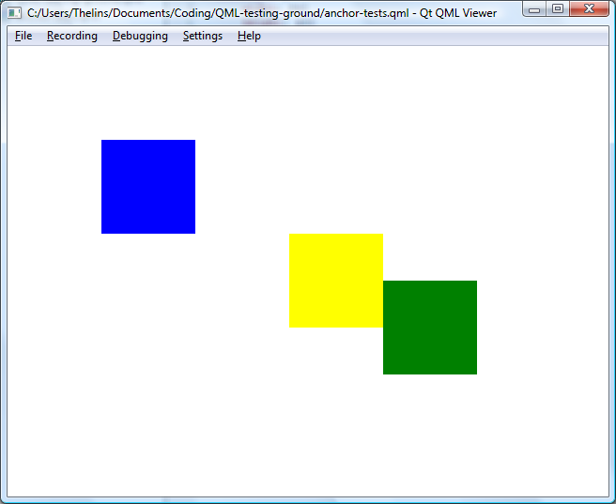
Anchor Layouts
Anchor layouts can be used to anchor elements to each other
Rectangle {
Rectangle {
anchors.fill: parent
...
}
...
}
Rectangle {
id: leftRectangle
...
}
Rectangle {
anchors.left: leftRectangle.right
...
}
Notes:
It is possible to use classic Qt layouts (vertical, horizontal and grid) in QML user interfaces. However, the fluid nature of modern device user interfaces makes them feel limiting.
Instead, anchor layouts are commonly used.
They can be used to fill one item with another item
They can also be used to anchor one side of one element to the side of another element
In the example, the left side of the green rectangle has been locked to the right side of the yellow one, while the blue rectangle fills its parent rectangle
The nature of the anchor layouts also makes it possible to link one element to multiple other elements. Comparing it to the classic layouts, anchor layouts are more flexible and powerful, but can also be more complex to use.
Continues

Slide 17

Layouts and Margins
You can combine anchor layouts with margins
Rectangle {
Rectangle {
anchors.fill: parent
anchors.margins: 5
...
}
...
}
Rectangle {
id: leftRectangle
...
}
Rectangle {
anchors.left: leftRectangle.right
anchors.leftMargin: 10
...
}
Notes:
By employing margins, it is possible to fine tune anchor based layouts
For instance, the blue rectangle can use a 5 pixel margin all the way around, thus exposing parts of its gray parent
Adding a 10 pixel left margin to the green rectangle adds some spacing between the yellow and green rectangles
Continues

Slide 18
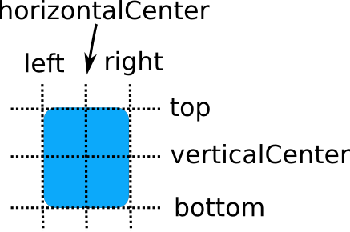
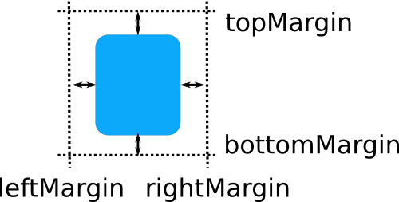
Anchor Layout Properties
You can anchor items to
  left, top, right, bottom
  verticalCenter, horizontalCenter
  baseline
You can specify individual
margins or anchors.margins
Notes:
Generally speaking, items can be anchored to all the sides and centers of other items.
Text items additionally have a base line, i.e. the base line of the text on which most characters stand (g, j, p and q go beneath the base line)
You can also specify margins on all sides – either individually or for all sides at once
Continues

Slide 19

Other Layouts
Using the Grid, Row and Column containers, classic layouts can be built
  Does not work if x or y are bound
  The spacing property is available for all
  The columns property controls the size of grids
Grid {
columns: 2
spacing: 5
Rectangle { width: 20; height: 20; color: "red" }
Rectangle { width: 20; height: 20; color: "green" }
Rectangle { width: 20; height: 20; color: "blue" }
}
Notes:
It is good to know that the classic layouts exist in QML as well.
They are known as Grid, Row and Column
If using them, do not bind or alter the x and y properties, as this confuses the layout system.
You can control the spacing for all types of layouts.
For the grid layout, you can control the number of columns, thus controlling the size of the overall grid

Slide 20
Break

Slide 21
Adding Interaction
Interaction is handled through areas separated from the visuals
  MouseArea – an area accepting mouse events
  GestureArea – an area accepting gesture events
    Requires touch events
    Single touch devices might only provide mouse events, check your device's documentation
  Keyboard events are handled through focus
Notes:
In Qt Quick, the visuals are separated from interaction areas to a larger degree than when using classic widgets
Interaction is handled through areas.
The MouseArea accepts mouse events
The GestureArea accepts gestures. Notice that gestures are based on touch events. Some touch-based devices with single-point touch might only report mouse events. In this case, gestures do not work. Check the documentation for your specific device to learn!
Keyboard events are handled through the focus concept, where the item with focus receives key events.

Slide 22
Creating a Button
You can build a button from a Rectangle, Text and MouseArea
Rectangle {
width: 200; height 100;
color: "lightBlue"
Text {
anchors.fill: parent
text: "Press me!"
}
MouseArea {
anchors.fill: parent
onClicked: { parent.color = "green" }
}
}
Notes:
Having mouse events, we can build a button.
The example here creates a rectangle with some text in it. In addition to the text, the rectangle contains a MouseArea element. The mouse area fills the rectangle and reacts to the on-clicked event
As you can tell, the visual parts of the button, i.e. the rectangle and text, are separated from the MouseArea. The MouseArea is added to the scene as any other item, relying on the same layout mechanisms and acting as any other element.
Continues

Slide 23
JavaScript
Rectangle {
width: 200; height 100;
color: "blue"
Text {
anchors.fill: parent
text: "Press me!"
}
MouseArea {
anchors.fill: parent
onClicked: { parent.color = "green" }
}
}
What happened here?
We bound an anonymous
JavaScript function to a
signal.
Notes:
For the MouseArea, the onClicked event is bound to a piece of JavaScript.
When the clicked event takes place, the JavaScript is executed. It is possible to run JavaScript methods or, as here, an anonymous function declared in-line.

Slide 24
Building Components
Having to create each button as a set of three elements is not a feasible solution
It is possible to create components in QML
A component can then be instantiated as an element
Components can be kept in modules that are included into your QML files
Notes:
Having to create buttons from multiple elements each time is not a feasible solution, instead we must compose these elements into components
A QML component can be instantiated as elements in other QML files
Each QML file can be considered a component. Components can then be put into modules that can be imported into QML files. A module can be seen as a directory of component QML files.
Continues

Slide 25
A Button Component
Place the button in the Button.qml file
import Qt 4.7
Rectangle {
width: 200; height: 100;
color: "lightBlue"
property alias text: innerText.text
Text {
id: innerText
anchors.fill: parent
}
MouseArea {
anchors.fill: parent
onClicked: { parent.color = "green" }
}
}
Notes:
To build a component of the button, place the code in a file named Button.qml (notice capital B).
The definitions look almost identical. The top-level rectangle defines a property alias. This is so that the user of the button does not have to know that the text resides in the innerText element. Instead the property text of the innerText item is made available through its alias, text of the rectangle item.
Continues

Slide 26
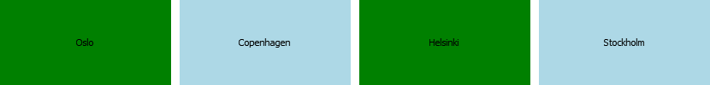
A Button Component
Instantiate buttons from your main QML file
  The main QML file must be placed in the same directory as Button.qml
  If not, you must import the directory containing Button.qml as a Module
import Qt 4.7
Row {
spacing: 10
Button { text: "Oslo" }
Button { text: "Copenhagen" }
Button { text: "Helsinki" }
Button { text: "Stockholm" }
}
Notes:
Using the button component from another QML file is then just a matter of instantiation of Button components.
This requires the Button.qml file to reside in the same directory as the main QML file. If not, it must be imported as a part of a module, but we will not go into that here as it is beyond the scope of this lecture.
Notice that the text property is available directly from the Button component, thanks to the property alias.
Continues

Slide 27
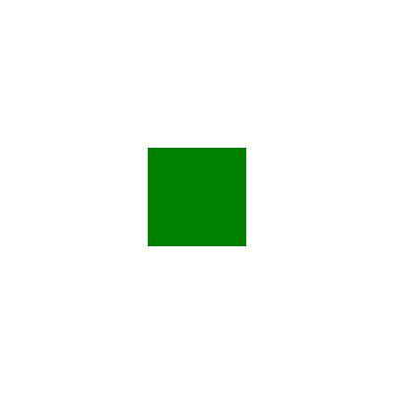


States
Using states, you can easily make smooth transitions between sets of property values
normal
large
rotated
Notes:
Until now, we've seen how to bind properties together, lay out elements, interact with the mouse and even how to animate properties. What we are missing is a plan to implement a fluid user interface.
For this, states are used. Each user interface can be in one or more states (states can be local to a part of the user interface, or affect all elements, you choose).
A state is simply a set of property values for one or more elements.
Let's look at an example with three states: normal, large and rotated – the screenshots next to each state show what to expect.
What we will do now is to make is possible to move between the states in a fluid way, with minimal code.
Continues

Slide 28
Defining States
The states property holds the states
import Qt 4.7
Rectangle {
width: 400; height: 400;
Rectangle {
id: myRect
width: 100; height: 100;
anchors.centerIn: parent
color: "green";
}
states: [
State { name: "normal" },
State { name: "large" },
State { name: "rotated" }
]
}
Notes:
First, let's define the overall scene. The myRect rectangle is the green rectangle from the screenshots in the previous slide.
In the top-level element we define a set of states consisting of the tree states: normal, large and rotated.
Continues

Slide 29
Defining States
Each state contains a set of property changes
Rectangle {
states: [
State { name: "normal"
PropertyChanges {
target: myRect
width: 100; height: 100;
rotation: 0
}
},
...
]
}
Notes:
For each state, we define a number of properties to change using PropertyChange elements.
For instance, for the normal state we set width and height to 100 and the rotation to zero degrees. All for the myRect element.
Where the “...” are, we find similar property changes for large and rotated.
Using this simple code, it is possible to switch between the states by setting the state property – but we want fluid transitions.
Continues

Slide 30
Making Smooth Transitions
The transitions property defines how to animate properties between states
Rectangle {
transitions: [
Transition {
from: "*"; to: "normal"
NumberAnimation {
properties: "width, height"
easing.type: Easing.InOutQuad
duration: 1000
}
NumberAnimation {
properties: "rotation"
easing.type: Easing.OutElastic
duration: 3000
}
},
...
]
}
Notes:
To implement fluid transitions (animate changing from one state to another) we rely on the transitions property. It contains a list of transitions. Each transition defines how each property is animated for each transition.
In this example, the transition from any other state “*”, to the normal state uses two number animations. The first changes width and height properties using an InOutQuad easing curve. The total transition takes 1000ms = 1 second.
An easing curve simply defines how the value is changed. It can be instantaneous, linear or accelerate according to different patterns. It can even bounce.
The rotation property follows the OutElastic easing curve, giving it a bouncing behavior. It changes during 3 seconds.
With these transitions in place, combined with the states, we have a way to switch between states in a fluid manner. All that we need to do now is to add the logic to actually change state.
Continues

Slide 31
Switching Between States
Set the state property
import Qt 4.7
Rectangle {
...
MouseArea {
anchors.fill: parent
onClicked: { if(parent.state == "normal") {
parent.state = "rotated";
} else if(parent.state == ...
}
}
Notes:
The state property holds the current state. Changing the state property triggers the transition to the next state.
This means that you can change state using any mechanism that you like, and the Qt Quick runtime will handle fluid transitions and animations for you automatically.
In this example, we alter state by implementing a small piece of code in the onClicked event of the MouseArea. Notice that all that the code does is change the state property. It does not have to do anything to get animated transitions. All is managed by the Qt Quick runtime.
Continues

Slide 32
Switching Between States
Or bind the state property to a value...
...which can form the link to C++
import Qt 4.7
Rectangle {
...
state: myState
}
Notes:
Another way to alter the state property is to bind it to another property value.
Such a property value could be controlled from C++. This gives us an elegant way to link the state of the QML user interface with the state of the business logic implemented in C++.
Continues

Slide 33
Global Variables
It is possible to bind to values exposed from JavaScript or C++
By binding to values from C++, the business logic can control the state
QML only controls the user interface, including transitions and effects
Notes:
It is possible to expose C++ values and objects as global variables in QML. The C++ value will be made available to all QML code at once and any changes of the property will be reflected in QML. This means that values can be bound to C++ values – no special code is needed on the QML side to react to changes.
By binding to these values, the C++ business logic can control parts of the QML world, for instance, the state, or any other property.
This gives us the split where QML is used for the user interface and C++ for the business logic. We are forced into separating the logic from the user interface and in return we get a better structured application code.
Continues

Slide 34
Integrating QML and C++
QML is executed by an QDeclarativeEngine
Each component can be created
The common component is a QGraphicsObject, but can be any QObject
QGraphicsScene *scene = myExistingGraphicsScene();
QDeclarativeEngine *engine = new QDeclarativeEngine;
QDeclarativeComponent component(engine, QUrl::fromLocalFile("myqml.qml"));
QGraphicsObject *object =
qobject_cast<QGraphicsObject *>(component.create());
scene->addItem(object);
Notes:
Looking at Qt Quick from C++, we see the QtDeclarative module. It contains a number of classes for executing QML
QML is executed using a QDeclarativeEngine
Components can be created using the QDeclarativeComponent class, combined with an engine
The common component is a QGraphicsObject, but it can be any QObject in theory.
In the example above, an engine and component are created and the object given when creating (instantiating) the component is added to a QGraphicsScene
Continues

Slide 35
Integrating QML and C++
The convenience widget QDeclarativeView can be used
  Contains an engine
  Handles the creation of components
QDeclarativeView *qmlView = new QDeclarativeView;
qmlView->setSource(QUrl::fromLocalFile("myqml.qml"));
Notes:
If you do now have an existing QGraphicsView to run QML on, a QDeclarativeView can be used directly
It contains an engine and manages the creation of components
Continues

Slide 36
Controlling Properties from C++
The rootContext of an engine can be accessed
The setContextProperty method can be used to set global variable values
QDeclarativeView *qmlView = new QDeclarativeView;
QDeclarativeContext *context = qmlView->rootContext();
context->setContextProperty("myState", QString("normal"));
qmlView->setSource(QUrl::fromLocalFile("myqml.qml"));
Notes:
Given a view or an engine, a QDeclarativeContext can be acquired. This context contains the global variables of the QML space
Using the setContextProperty method, new variables can be created and set.
In the example here, myState is set to normal
Continues

Slide 37
Bound, not Assigned
As QML binds values, instead of assigning them, changing a context property from C++ changes the value in QML
void Window::rotateClicked()
{
QDeclarativeContext *context = qmlView->rootContext();
context->setContextProperty("myState", QString("rotated"));
}
void Window::normalClicked()
{
QDeclarativeContext *context = qmlView->rootContext();
context->setContextProperty("myState", QString("normal"));
}
void Window::largeClicked()
{
QDeclarativeContext *context = qmlView->rootContext();
context->setContextProperty("myState", QString("large"));
}
Notes:
By updating a context property, the variable is changed on the QML side. As values are bound and not assigned, this can be used to drive a user interface
In the example here, a number of slots are used to update the myState global variable
Continues

Slide 38
Exposing QObject
Exposing a QObject as a context property, exposes slots
QDeclarativeView *qmlView = new QDeclarativeView;
QLabel *myLabel = new QLabel;
QDeclarativeContext *context = qmlView->rootContext();
context->setContextProperty("theLabel", myLabel);
MouseArea {
anchors.fill: parent
onClicked: { theLabel.setText("Hello Qt!"); }
}
Notes:
It is not only possible to drive QML from C++, the other direction is possible as well
By exposing a QObject (derived) object as a context property, all slots are available to QML and can be called.
In the example, a QLabel is exposed to QML. From QML, the setText slot is called. Thus driving an event from QML to C++
This is the final piece of the puzzle – now you can build a user interface in QML and your business logic in C++.
There is much more to Qt Quick, but this introduction has shown you the basic concepts.

